Slide 1
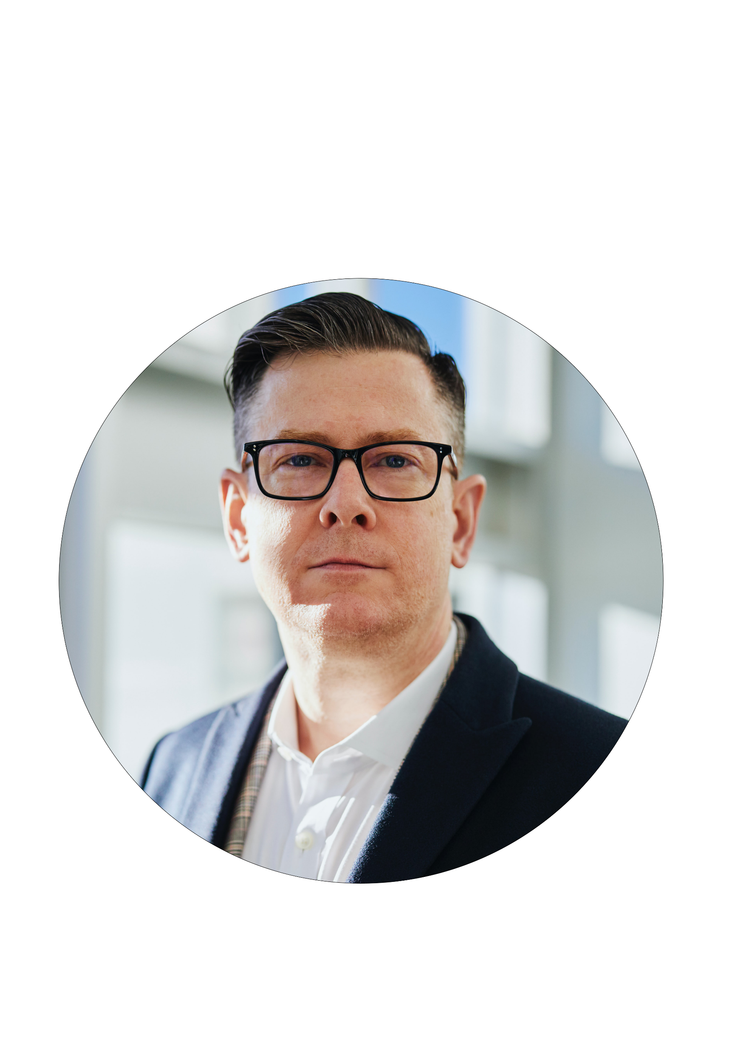
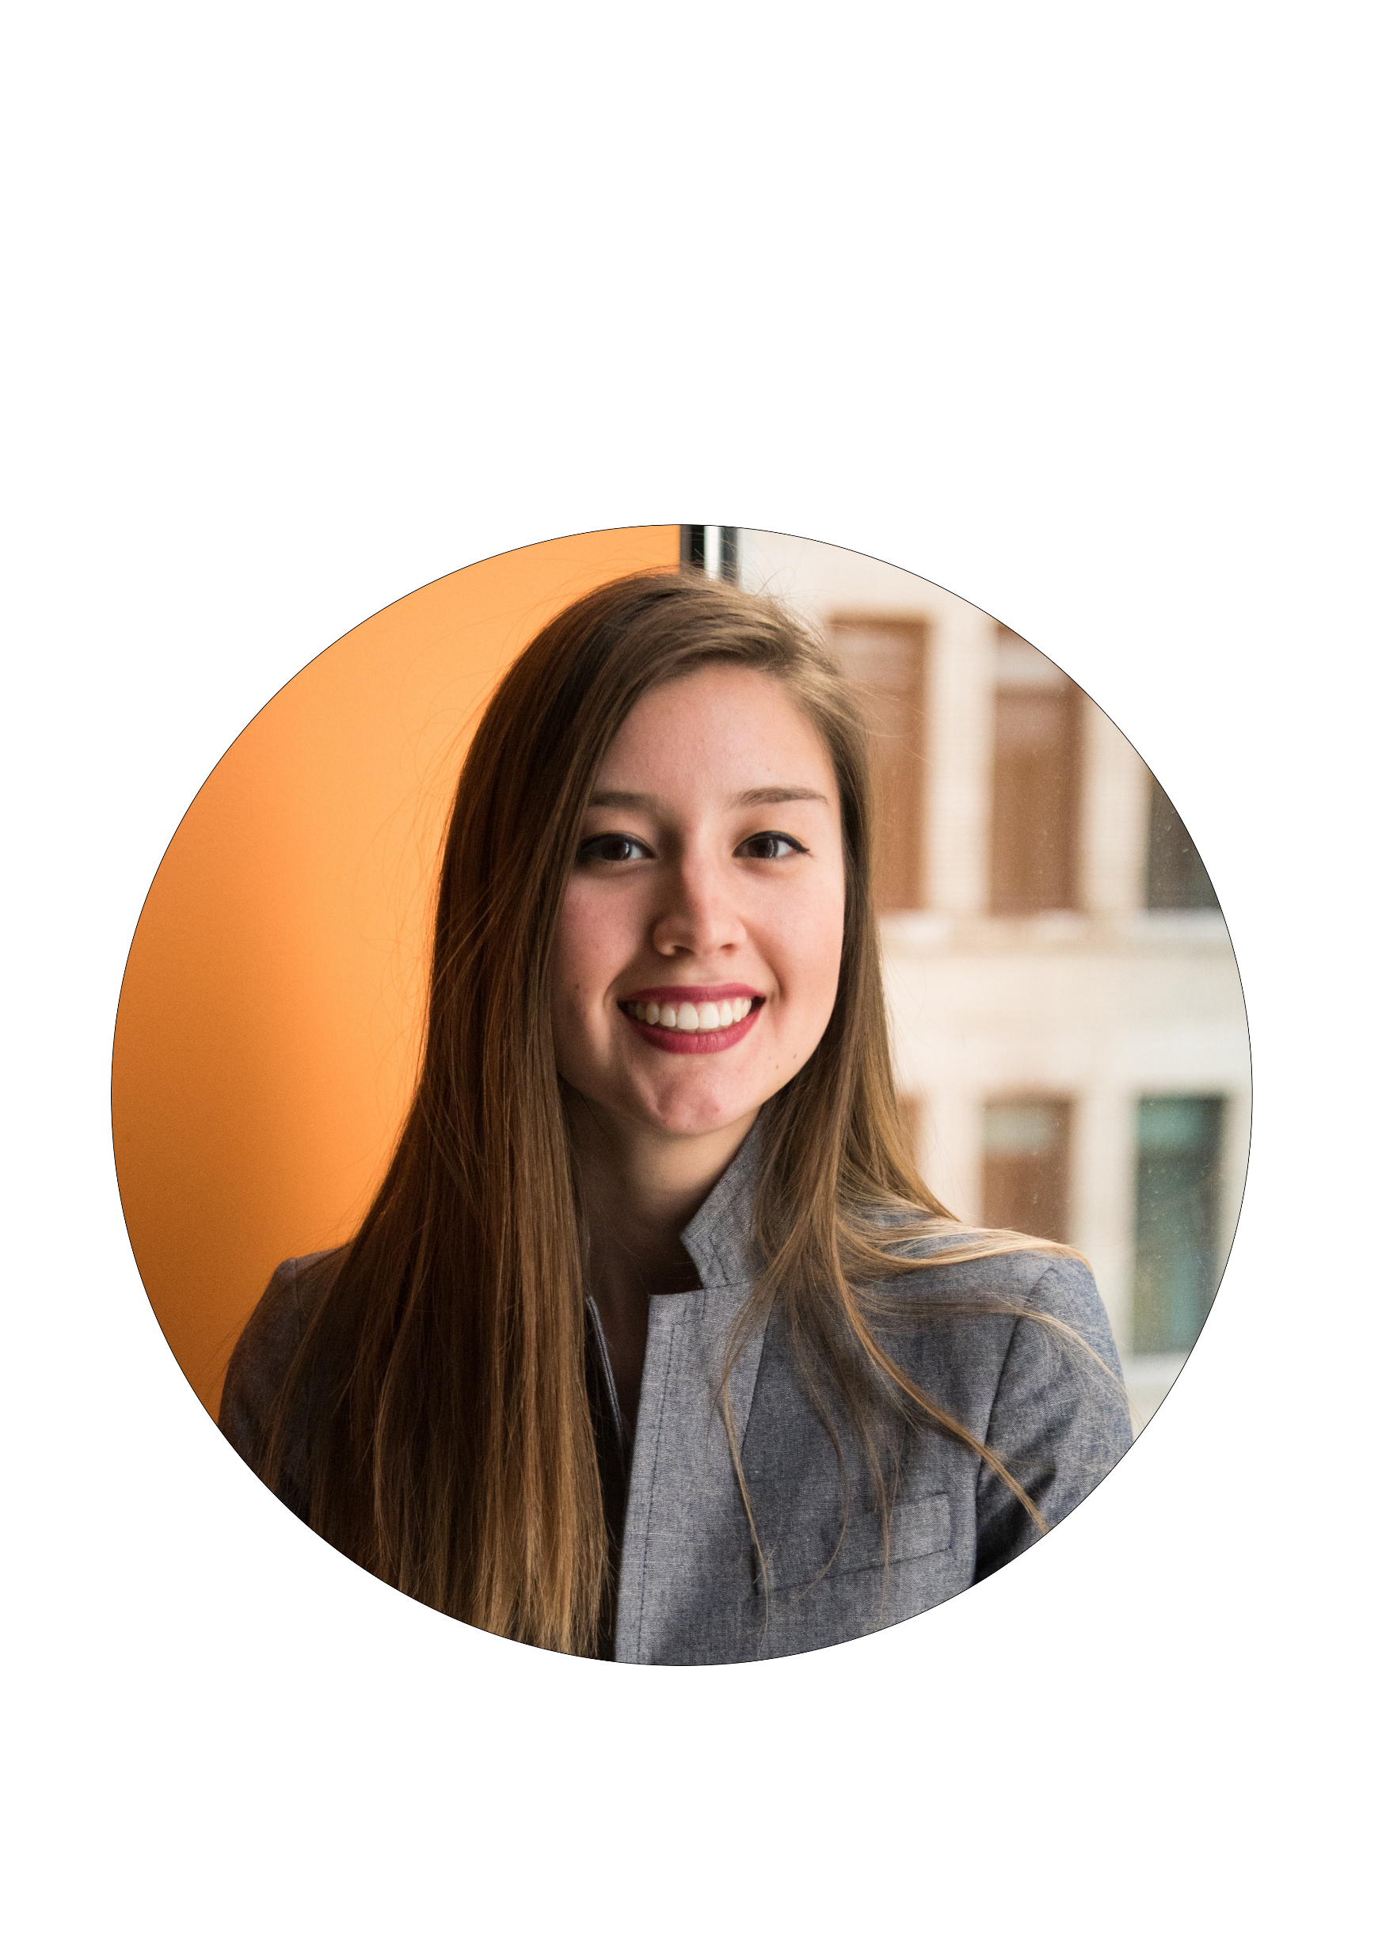
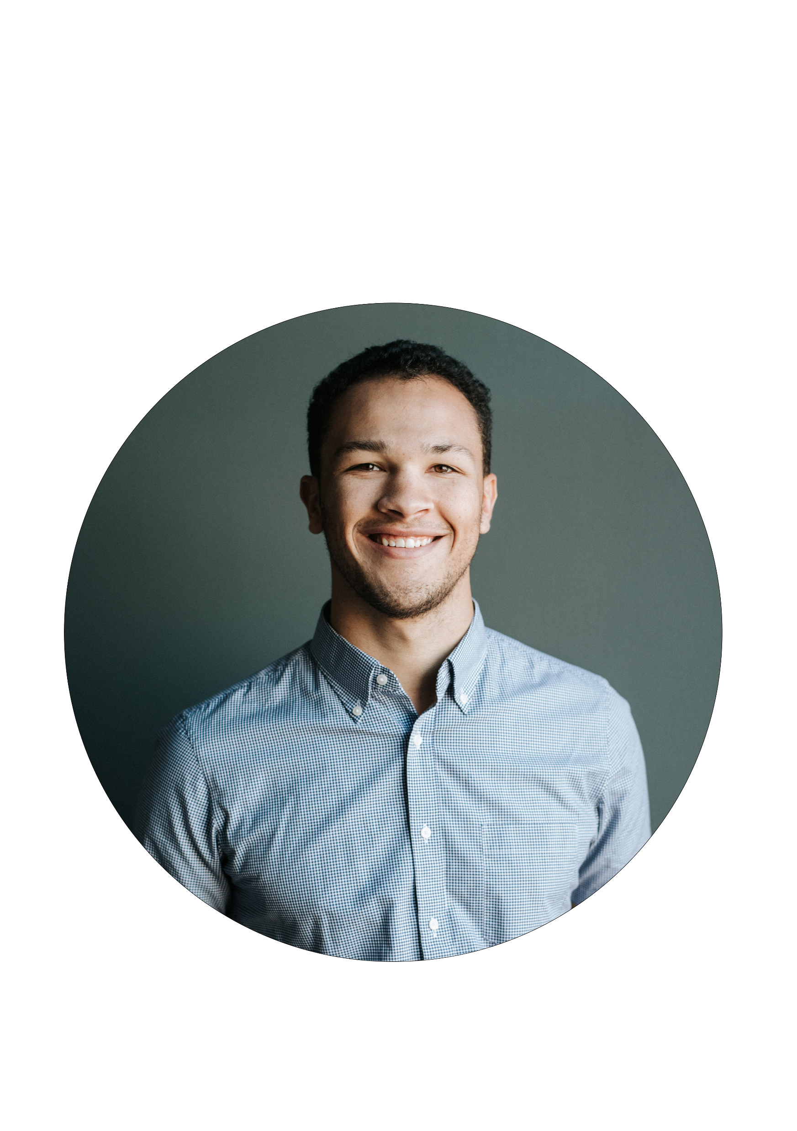
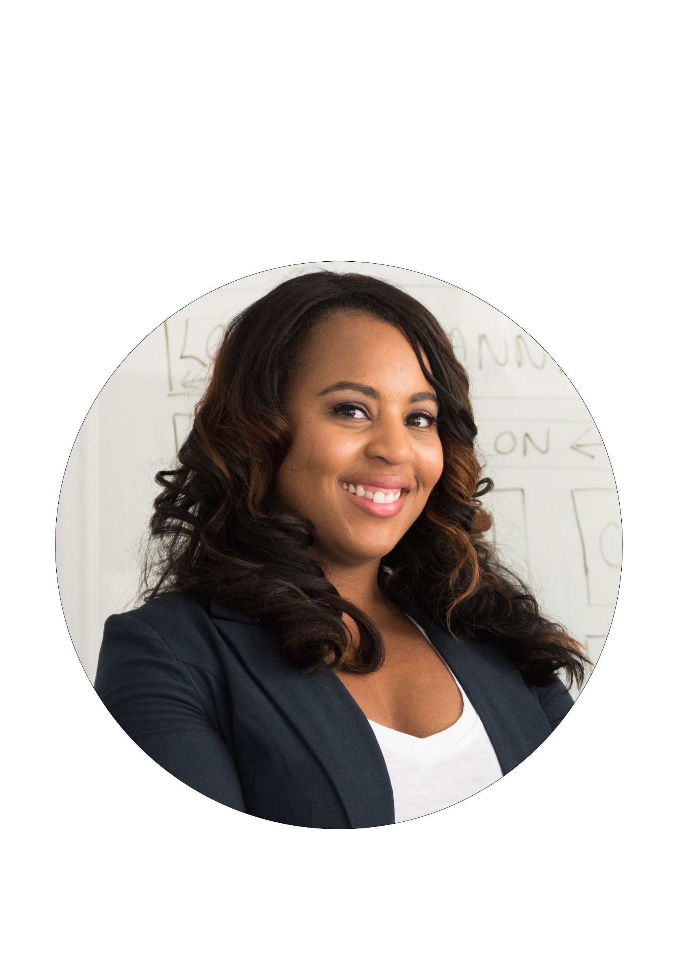
LOGO HERE
MEET OUR TEAM
Richard Williams
CEO
Lauren Reeves
General Manager
Richard Williams
Product Lead
Richard Williams
Product Lead

